Slide 1
Lecture 11

Slide 2
The State Pattern

Slide 3
Employed when
There is a collection of states, with each state being defined by
distinct behavior.
A set of external inputs to which the system must respond.
A context in which the FSM operates

Slide 4
Features of the Context
A field to track the current state of the FSM.
A mechanism to record the change of state.
A mechanism to effect the change of state. (Optional)
Methods for entities outside the system to communicate with the FSM. (Optional)
Keep track of external entities that may need to be notified in response to internal changes. (Optional)

Slide 5
Replacing Conditionals with Polymorphism
public void cookRequested() {
if (currentState == States.DOOR_CLOSED_STATE) {
} else if (currentState == States.COOKING_STATE) {
}
}

Slide 6
The State Hierarchy

Slide 7
Transitioning Between States
Centralized Representation
Localized Representation

Slide 8
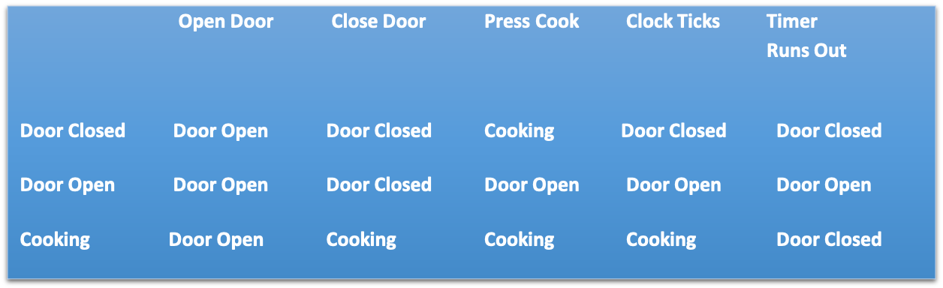
Centralized Representation Uses a Table
int[][] transitions =
{
{1, 0 , 2 , 0 , 0},
{1, 0 , 1 , 1 , 1},
{1, 2 , 2 , 2 , 0}
};

Slide 9
An External Entity Populates the Table And Makes the Changes When Needed
public void changeCurrentState(int next) {
currentState = transitions[currentState][next];
}

Slide 10
Localized Representation Uses Executable Statements Within State Classes
MicrowaveContext.instance().changeCurrentState
(CookingState.instance());

Slide 11
MicrowaveState

Slide 12
DoorClosedState

Slide 13
Loosely Coupled Communication

Slide 14
Properties
The listener is responsible for registering interest.
All interested listeners share some common interface so that the sender need not distinguish between listeners.
The sender has a mechanism for maintaining a collection of the interested listeners.

Slide 15
The Observer Pattern
Observable, which is usually a single object, and
Observers, of which there may be several.
It is the responsibility of the Observable to provide a method by which the Observer can register interest.
Once this interest has been registered, it is the responsibility of the Observable to notify all Observers of any changes/events that occur

Slide 16
There is an Observable class and an Observer interface in Java, but…
It is deprecated. So let us not use it.

Slide 17
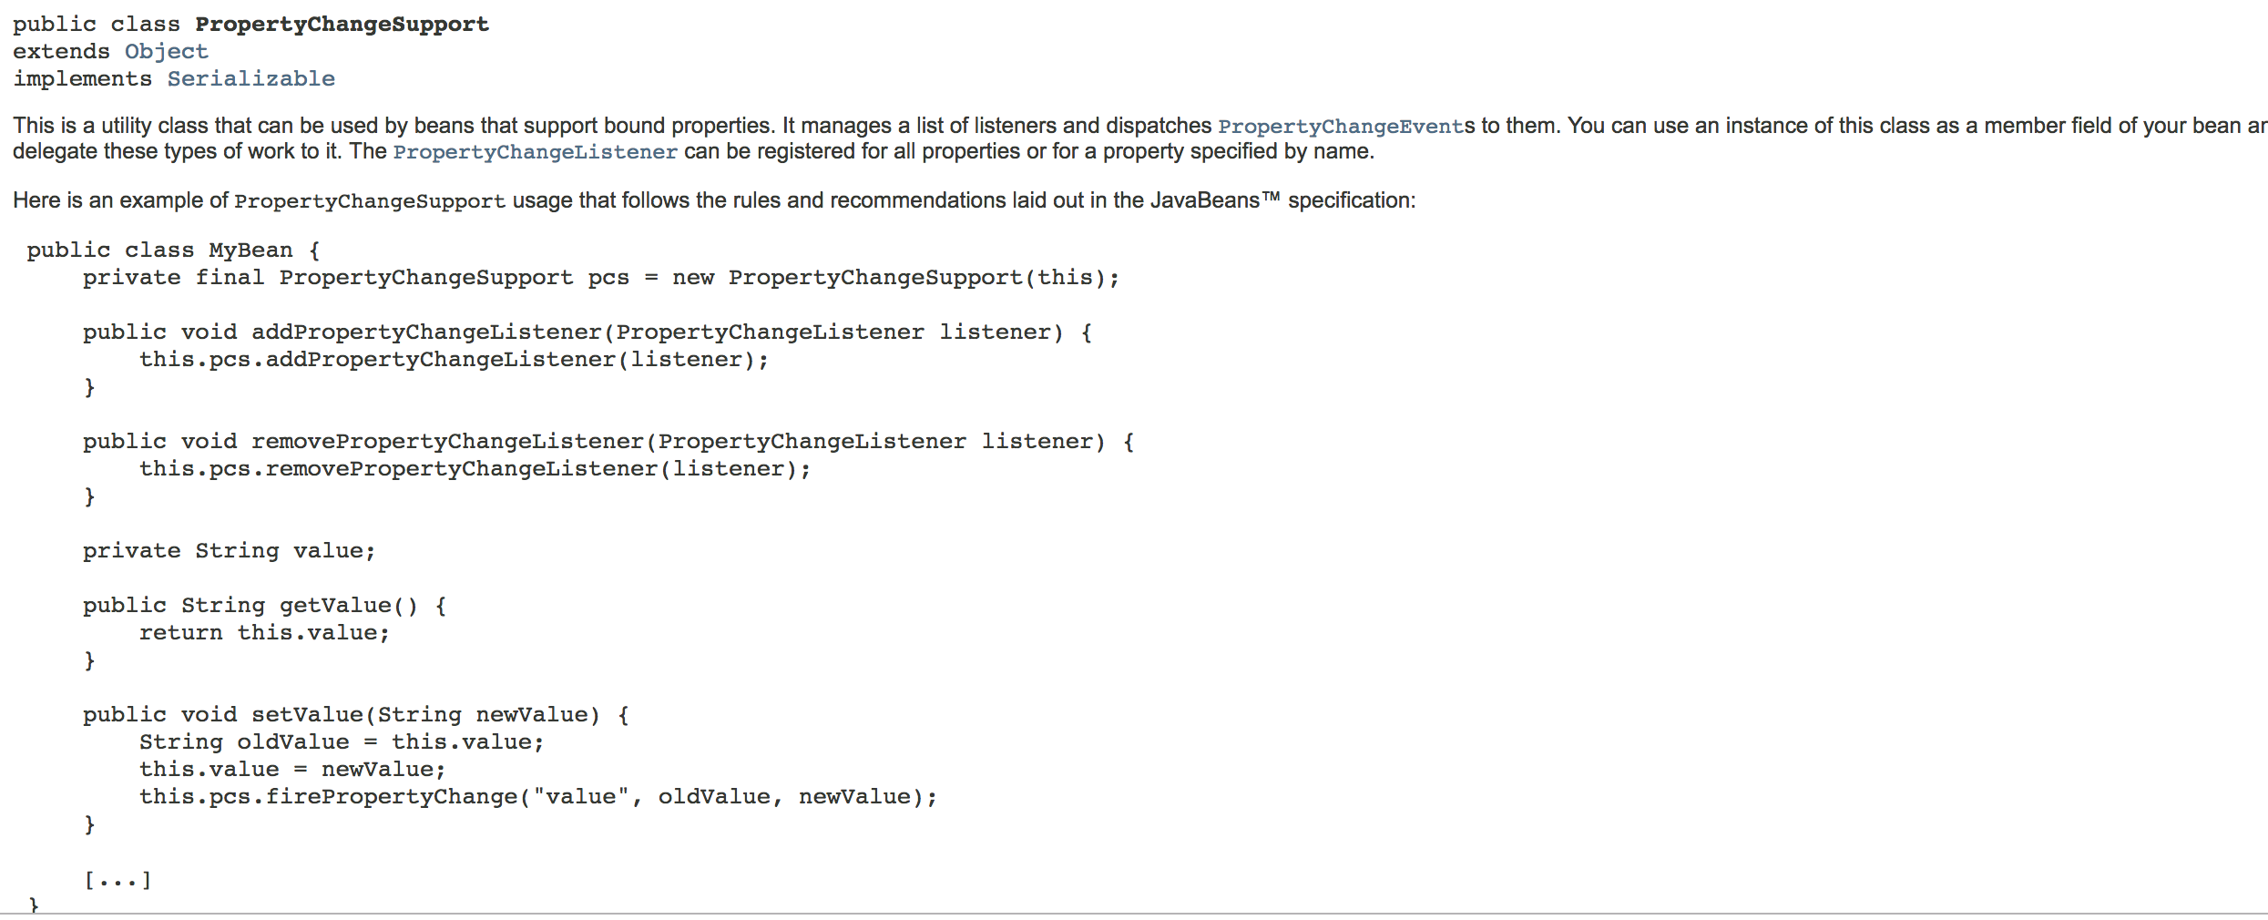
The PropertyChangeSupport class in the JDK

Slide 18
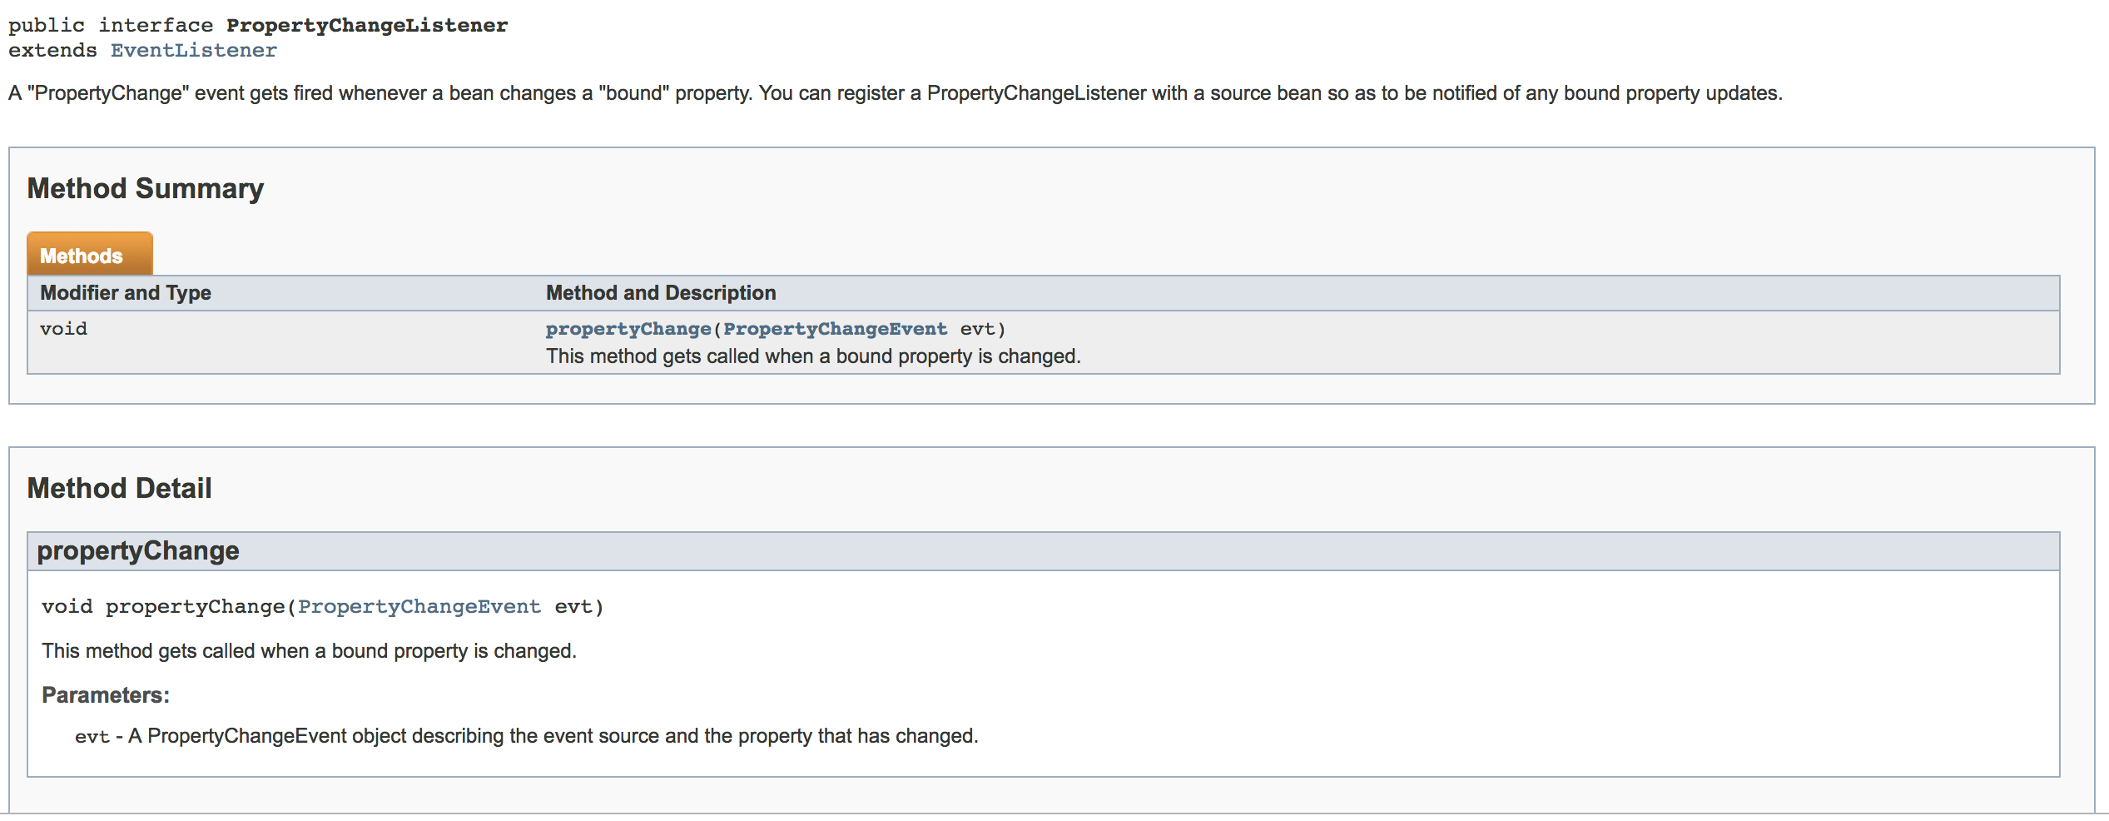
The PropertyChangeListener Interface

Slide 19
How Does The Pattern Work?

Slide 20
Timing the Cooking

Slide 21
A Timer Class
The timer must be ”connected” to an object
Set up a timer for a certain duration
A signal when the timer runs out
A signal that arrives periodically
Pause and resume the timer
Periodic signals
Change the timing
Kill the timer

Slide 22
The Clock is an Observable

Slide 23
Should the Timer and its Client be Implemented Using the Observer Pattern?
Advantage: Well known paradigm
Drawback: Usually, only one client per timer; not worth the overhead
This means create a new interface

Slide 24
The Notifiable Interface

Slide 25
The Timer Class

Slide 26
Which class should manage the Timer?
MicrowaveContext: What if we need multiple timers?
CookingState: The class need not have to depend on others (if possible) to manage its show

Slide 27
Should the Display be Updated Directly by the State Classes?
Perhaps all communication goes through the context: Allows the system to inter-operate with several environments.
Each state communicates independently with the display: Appropriate if each state class has a different set of entities to deal with.
Neither case applies here at this time. But the first is more likely for this application.

Slide 28
Eliminating the Conditonals
in the GUI

Slide 29
Conditionals in the GUI
public void handle(ActionEvent event) {
if (event.getSource().equals(doorCloser)) {
MicrowaveContext.instance().doorClosed();
} else if (event.getSource().equals(doorOpener)) {
MicrowaveContext.instance().doorOpened();
} else if (event.getSource().equals(cookButton)) {
MicrowaveContext.instance().cookRequested();
}
}

Slide 30
Create a hierarchy of Button classes
The conditionals are based on the button
So create a hierarchy of buttons

Slide 31
Here is the Hierarchy

Slide 32
Now, some events have info attached to them.
So we might want to encapsulate the info in event objects
For example, when the timer ticks, create a TimerTickedEvent object with the remaining time value.

Slide 33
Here is the Event Hierarchy

Slide 34
Most Events Don’t Have Any Data
CookRequestedEvent
TimerRanOutEvent
DoorClosedEvent
DoorOpenedEvent

Slide 35
Creation of Event Instances
If an event has associated data, it should be created every time. This is true of TimerTickedEvent.
For others, what should we do?
We could create an instance: for the sake of uniformity
Or make them singletons, for the sake of efficiency

Slide 36
Event Handling
Event handling can be in specifically named methods as we have been doing before or
Events could be handled in uniformally-named methods like
handleEvent()
With one method per event. The parameter would be an event. Distinguished by the parameter type.

Slide 37
Delivering the Events
Each GUI event would be delivered to the context by the buttons
The Timer events would be delivered to CookingState

Slide 38
Implementation

Slide 39
The Clock
public class Clock implements Runnable {
private final PropertyChangeSupport propertyChangeSupport =
new PropertyChangeSupport(this);
public void addPropertyChangeListener(PropertyChangeListener listener) {
this.propertyChangeSupport.addPropertyChangeListener(listener);
}
public void run() {
try {
while (true) {
Thread.sleep(1000);
this.propertyChangeSupport.firePropertyChange(null, null, null);
}
} catch (InterruptedException ie) {
}
}
}

Slide 40
The Timer class
public class Timer implements PropertyChangeListener {
private int timeValue;
private Notifiable client;
public Timer(Notifiable client, int timeValue) {
this.client = client;
this.timeValue = timeValue;
Clock.instance().addPropertyChangeListener(this);
}

Slide 41
All event handling methods have the same name: handleEvent.
public interface Notifiable {
public void handleEvent(TimerTickedEvent event);
public void handleEvent(TimerRanOutEvent event);
}

Slide 42
Timer continued
public void addTimeValue(int value) {
timeValue += value;
}
public void stop() {
Clock.instance().removePropertyChangeListener(this);
}
@Override
public void propertyChange(PropertyChangeEvent arg0) {
if (--timeValue <= 0) {
client.handleEvent(TimerRanOutEvent.instance());
Clock.instance().removePropertyChangeListener(this);
} else {
client.handleEvent(new TimerTickedEvent(timeValue));
}
}

Slide 43
The Superclass for All Buttons
public abstract class GUIButton extends Button
implements EventHandler<ActionEvent> {
public GUIButton(String string) {
super(string);
setOnAction(this);
}
}

Slide 44
CookButton as An Example
public class CookButton extends GUIButton implements EventHandler<ActionEvent> {
@Override
public void handle(ActionEvent event) {
MicrowaveContext.instance().handleEvent(CookRequestEvent.instance());
}
}

Slide 45
MicrowaveState
public abstract class MicrowaveState {
public abstract void enter();
public abstract void leave();
public void handleEvent(CookRequestEvent event) {
}
public void handleEvent(DoorOpenEvent event) {
}
public void handleEvent(DoorCloseEvent event) {
}
public void handleEvent(TimerTickedEvent event) {
}
public void handleEvent(TimerRanOutEvent event) {
}
}

Slide 46
The Context Methods for Handling Events
public void handleEvent(CookRequestEvent event) {
currentState.handleEvent(event);
}
public void handleEvent(DoorOpenEvent event) {
currentState.handleEvent(event);
}
public void handleEvent(DoorCloseEvent event) {
currentState.handleEvent(event);
}

